Slide 1
CMSC 28100 Introduction to Complexity Theory Autumn 2025 Instructor: William Hoza
⏳

Slide 2

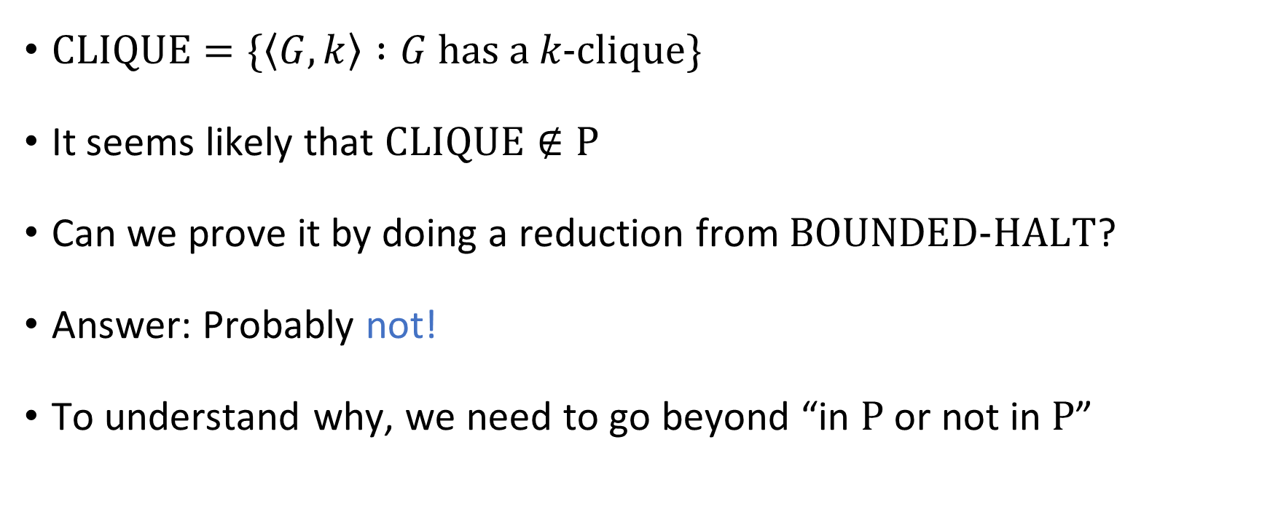

What about $\text{CLIQUE}$?
$\text{CLIQUE}=\{\left\langle G,k\right\rangle :G \text{has} \text{a} k\text{‑}\text{clique}\}$
It seems likely that $\text{CLIQUE}∉\text{P}$
Can we prove it by doing a reduction from $\text{BOUNDED}\text{‑}\text{HALT}$?
Answer: Probably not!
To understand why, we need to go beyond “in $\text{P}$ or not in $\text{P}$”

Slide 3
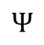
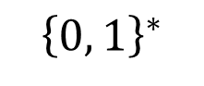
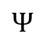
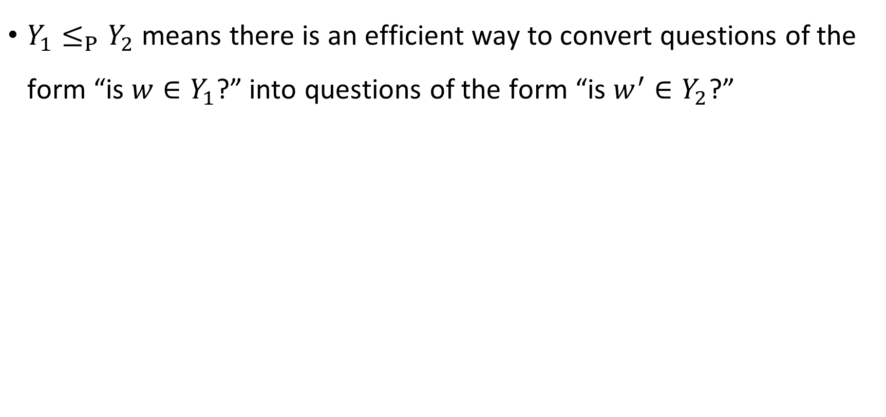
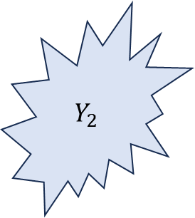
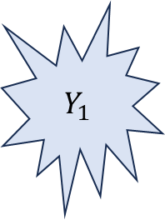
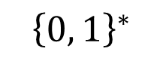
Mapping reductions
$Y_{1}≤_{P}Y_{2}$ means there is an efficient way to convert questions of the form “is $w∈Y_{1}$?” into questions of the form “is $w^{′}∈Y_{2}$?”
$$Ψ$$
$$Y_{2}$$
$$Y_{1}$$
$$Ψ$$
$${\left\{0, 1\right\}}^{∗}$$
$${\left\{0, 1\right\}}^{∗}$$

Slide 4
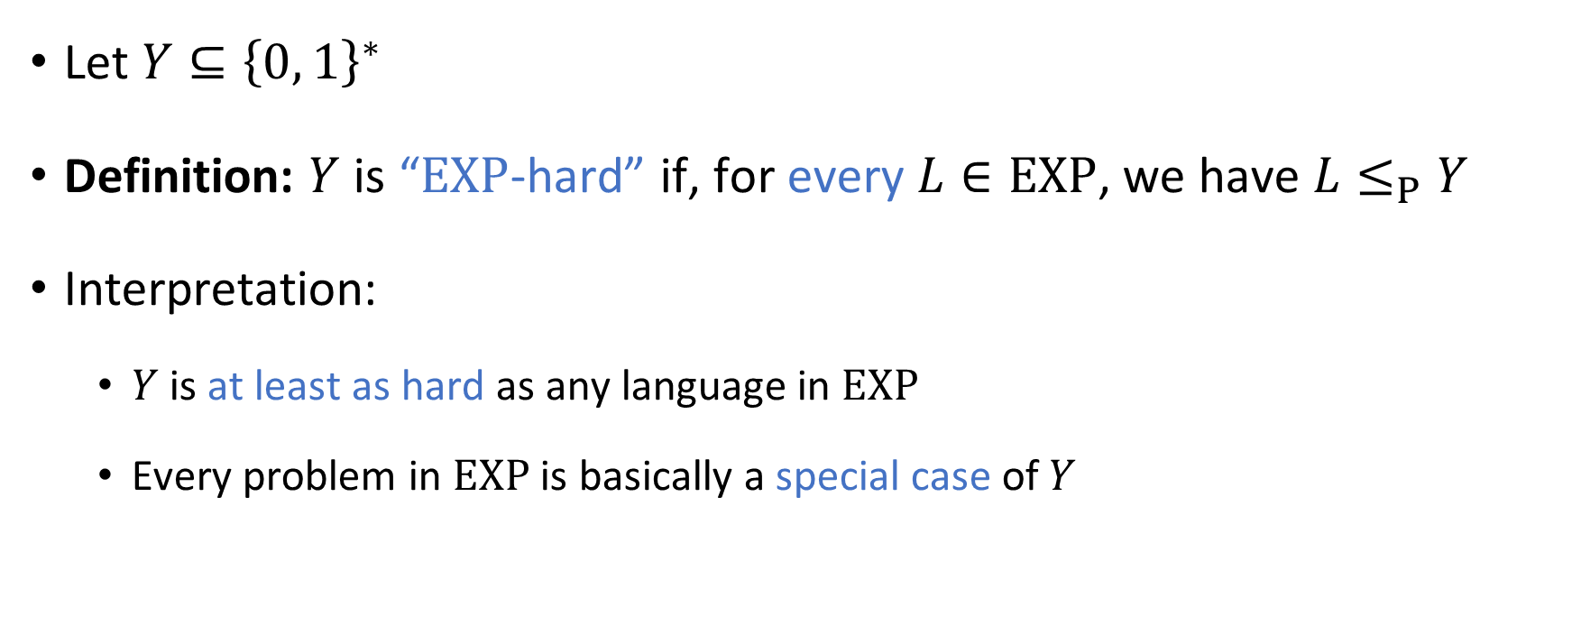
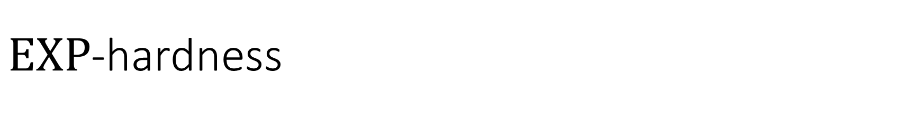
$\text{EXP}$-hardness
Let $Y⊆{\left\{0, 1\right\}}^{∗}$
Definition: $Y$ is “$\text{EXP}$-hard” if, for every $L∈\text{EXP}$, we have $L≤_{P}Y$
Interpretation:
$Y$ is at least as hard as any language in $\text{EXP}$
Every problem in $\text{EXP}$ is basically a special case of $Y$

Slide 5
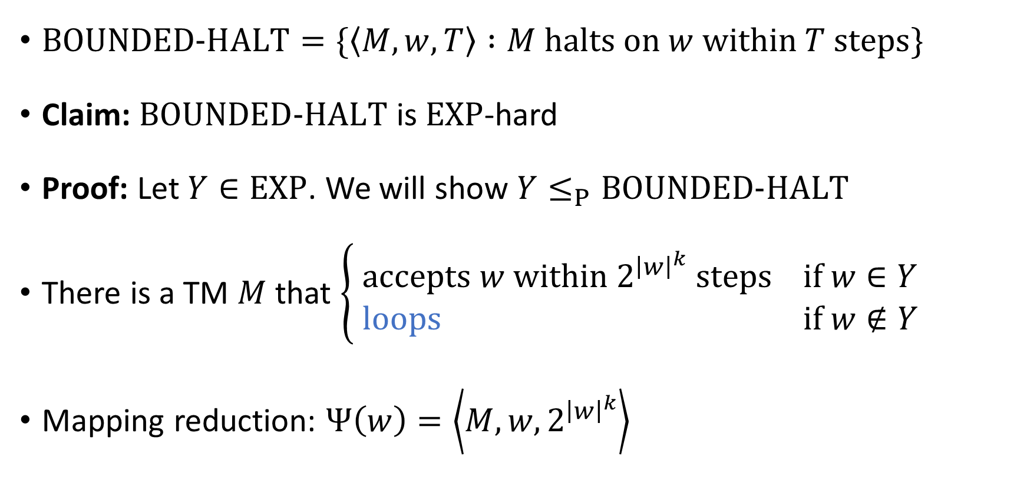

Example: $\text{BOUNDED}\text{‑}\text{HALT}$ is $\text{EXP}$-hard
$\text{BOUNDED}\text{‑}\text{HALT}=\{\left\langle M, w, T\right\rangle :M \text{halts} \text{on} w \text{within} T \text{steps}\}$
Claim: $\text{BOUNDED}‑\text{HALT}$ is $\text{EXP}$-hard
Proof: Let $Y∈\text{EXP}$. We will show $Y≤_{P}\text{BOUNDED}‑\text{HALT}$
There is a TM $M$ that $\left\{\begin{aligned} \text{accepts} w \text{within} 2^{{\left|w\right|}^{k}} \text{steps} \text{if} w∈Y \\ \text{loops} \text{if} w∉Y\end{aligned}\right.$
Mapping reduction: $Ψ\left(w\right)=\left\langle M,w,2^{{\left|w\right|}^{k}}\right\rangle$

Slide 6
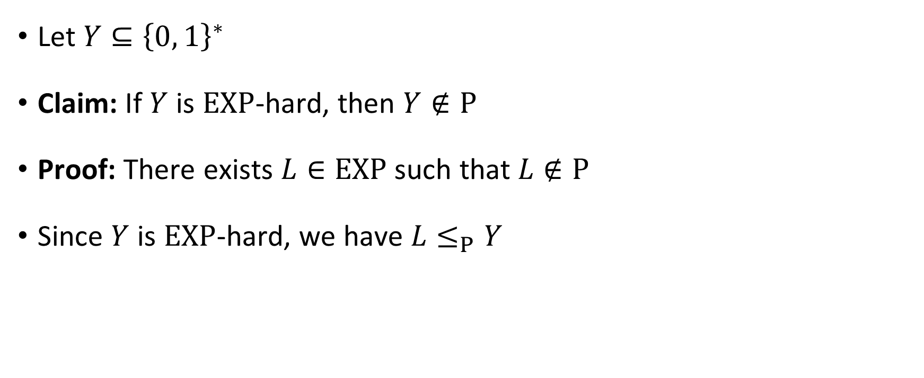
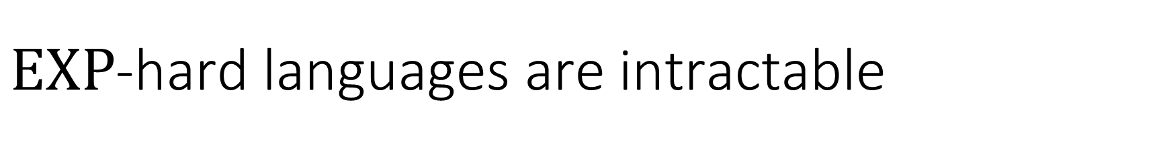
$\text{EXP}$-hard languages are intractable
Let $Y⊆{\left\{0, 1\right\}}^{∗}$
Claim: If $Y$ is $\text{EXP}$-hard, then $Y∉\text{P}$
Proof: There exists $L∈\text{EXP}$ such that $L∉\text{P}$
Since $Y$ is $\text{EXP}$-hard, we have $L≤_{P}Y$

Slide 7
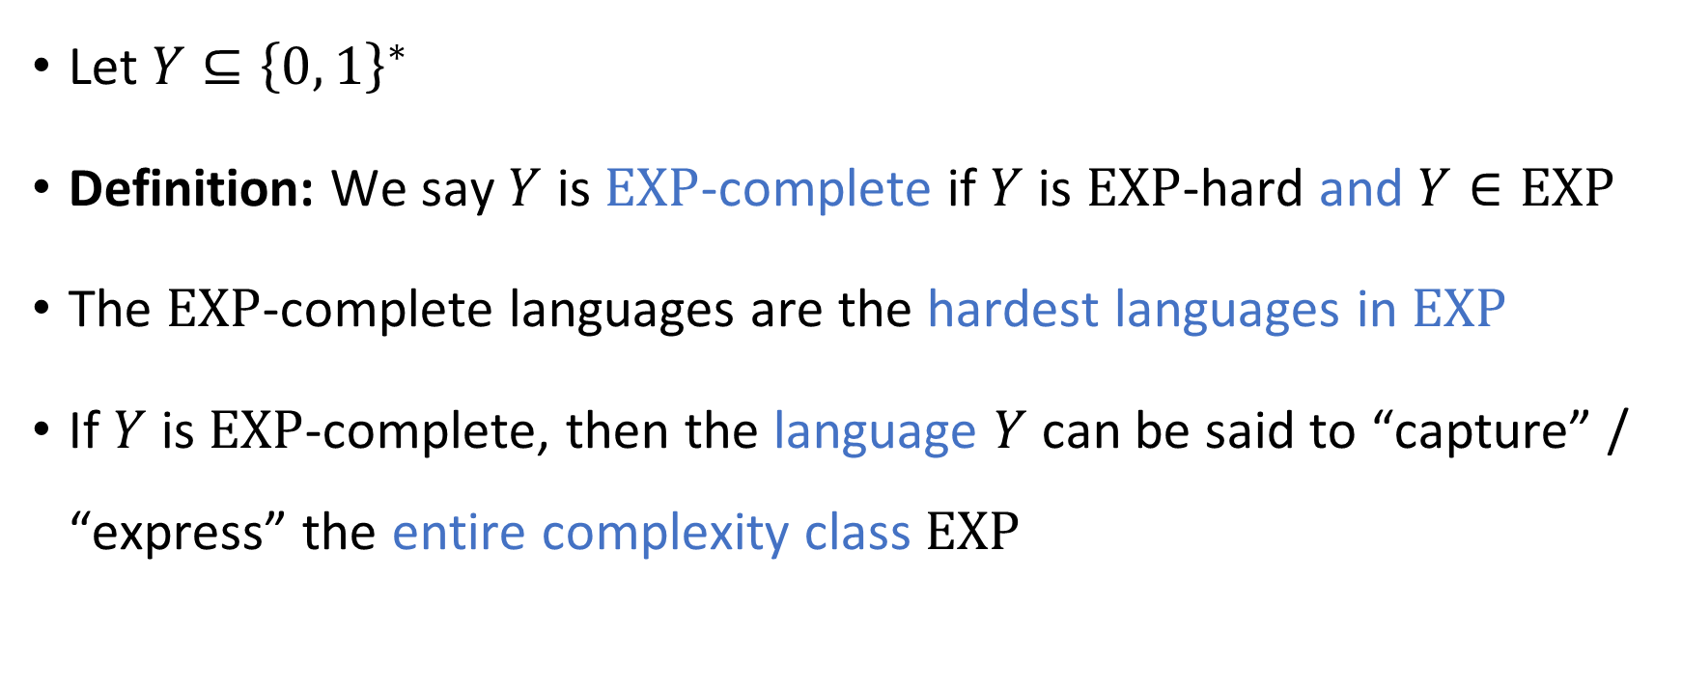
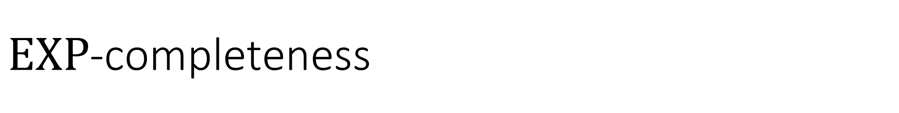
$\text{EXP}$-completeness
Let $Y⊆{\left\{0, 1\right\}}^{∗}$
Definition: We say $Y$ is $\text{EXP}$-complete if $Y$ is $\text{EXP}$-hard and $Y∈\text{EXP}$
The $\text{EXP}$-complete languages are the hardest languages in $\text{EXP}$
If $Y$ is $\text{EXP}$-complete, then the language $Y$ can be said to “capture” / “express” the entire complexity class $\text{EXP}$

Slide 8
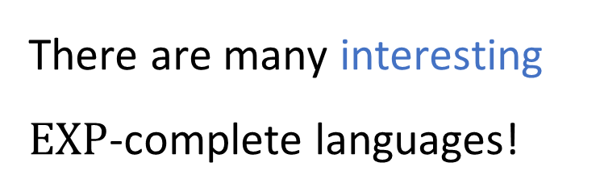
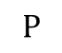
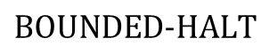
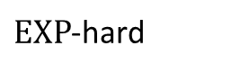

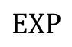
$\text{EXP}$-completeness
$\text{EXP}$-hard
$$\text{BOUNDED}\text{‑}\text{HALT}$$
$\text{EXP}$-complete
There are many interesting $\text{EXP}$-complete languages!
$$\text{EXP}$$
$$\text{P}$$

Slide 9
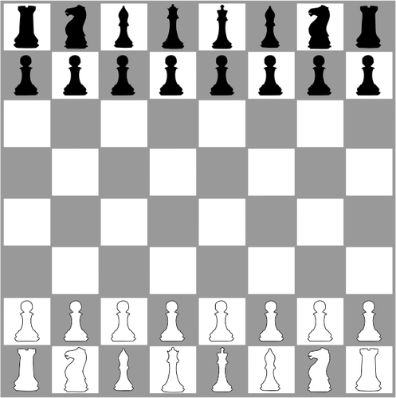
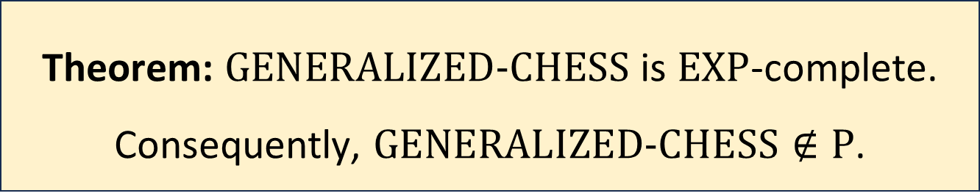
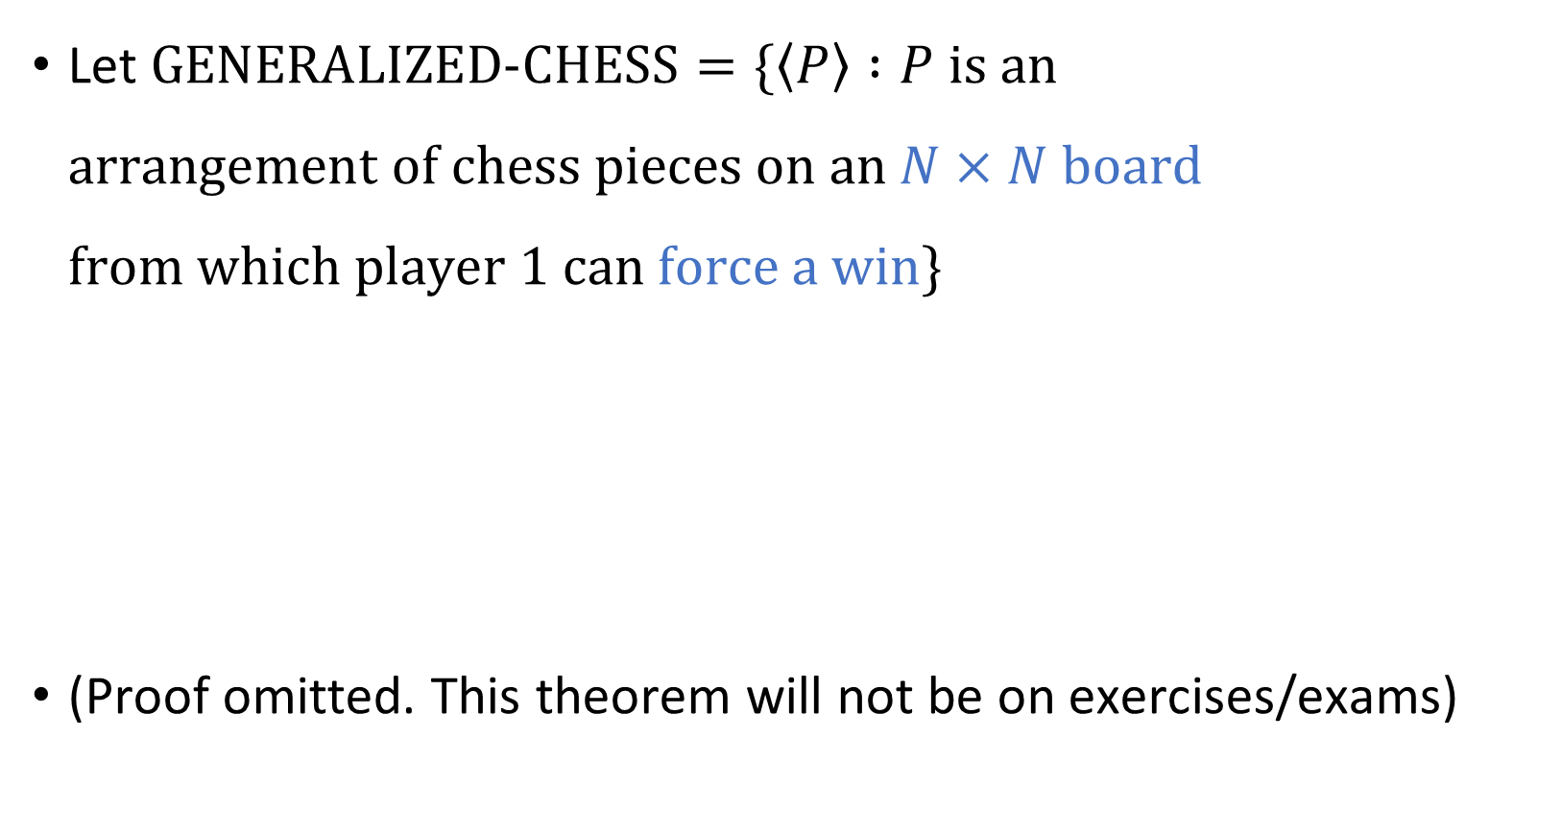
Example: Chess
Let $\text{GENERALIZED}\text{‑}\text{CHESS}=\{\left\langle P\right\rangle :P \text{is} \text{an}$ $\text{arrangement} \text{of} \text{chess} \text{pieces} \text{on} \text{an} N×N \text{board}$ $\text{from} \text{which} \text{player}\text{ 1 }\text{can} \text{force} \text{a} \text{win}\}$
(Proof omitted. This theorem will not be on exercises/exams)
Theorem: $\text{GENERALIZED}\text{‑}\text{CHESS}$ is $\text{EXP}$-complete. Consequently, $\text{GENERALIZED}\text{‑}\text{CHESS}∉\text{P}$.

Slide 10
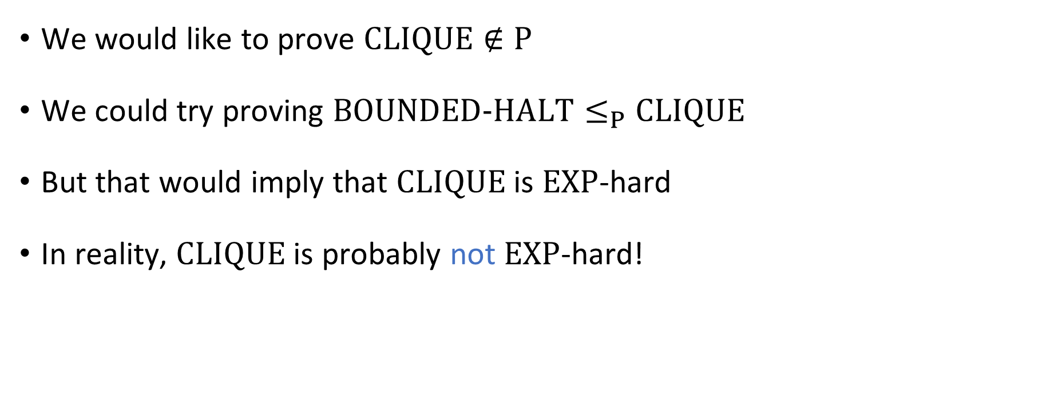
Why reductions don’t always work
We would like to prove $\text{CLIQUE}∉\text{P}$
We could try proving $\text{BOUNDED}‑\text{HALT}≤_{P}\text{CLIQUE}$
But that would imply that $\text{CLIQUE}$ is $\text{EXP}$-hard
In reality, $\text{CLIQUE}$ is probably not $\text{EXP}$-hard!

Slide 11
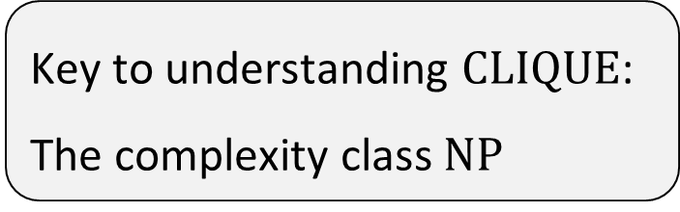
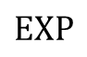
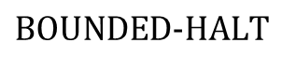
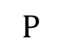
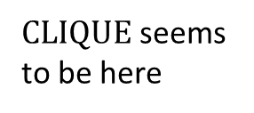
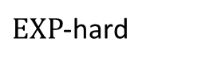
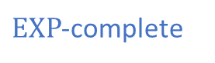
$\text{EXP}$-hard
$$\text{BOUNDED}\text{‑}\text{HALT}$$
$\text{EXP}$-complete
$\text{CLIQUE}$ seems to be here
$$\text{EXP}$$
Key to understanding $\text{CLIQUE}$:
The complexity class $\text{NP}$
$$\text{P}$$

Slide 12
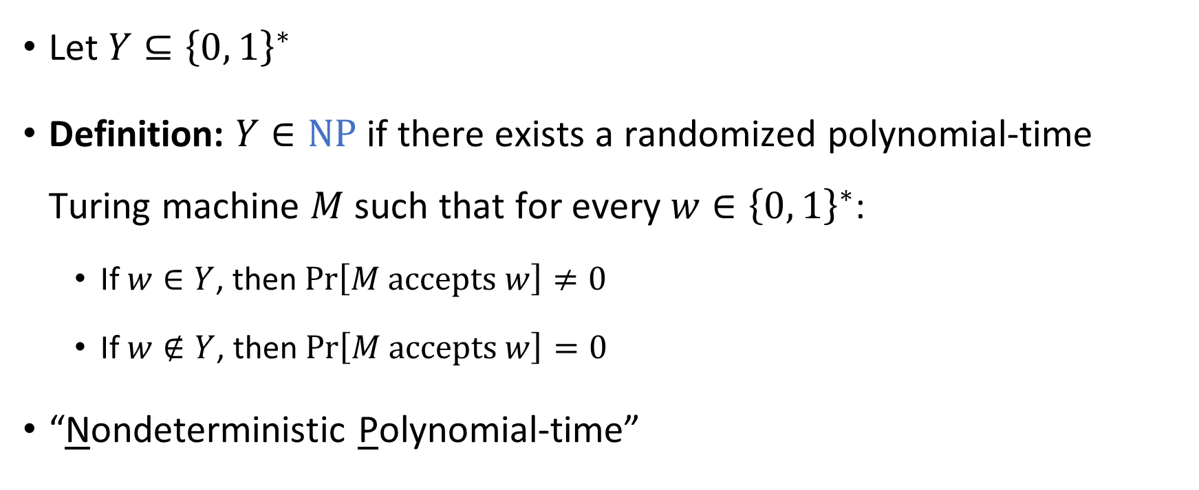

The complexity class $\text{NP}$
Let $Y⊆{\left\{0, 1\right\}}^{∗}$
Definition: $Y∈\text{NP}$ if there exists a randomized polynomial-time Turing machine $M$ such that for every $w∈{\left\{0, 1\right\}}^{∗}$:
If $w∈Y$, then $\operatorname{Pr}\left[M \text{accepts} w\right]≠0$
If $w∉Y$, then $\operatorname{Pr}\left[M \text{accepts} w\right]=0$
“Nondeterministic Polynomial-time”
“Nondeterministic Turing machine”

Slide 13
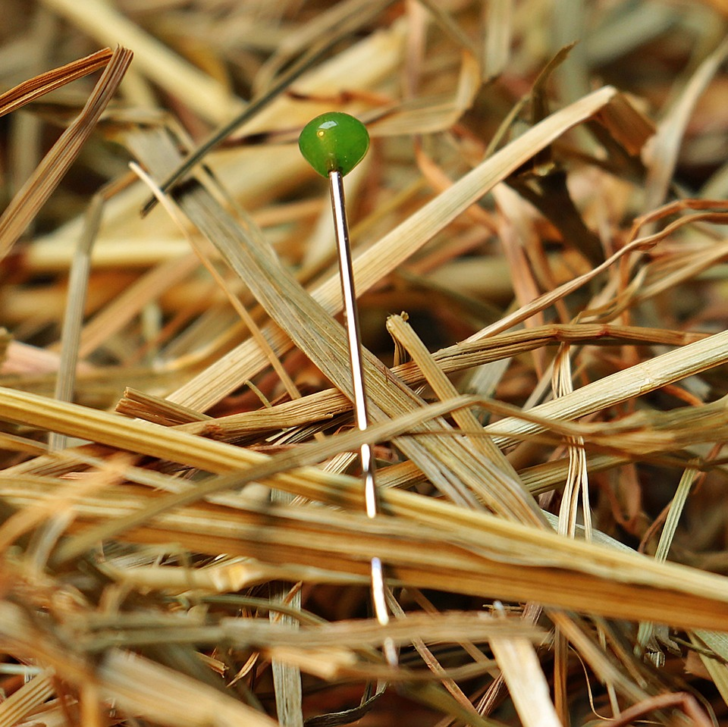
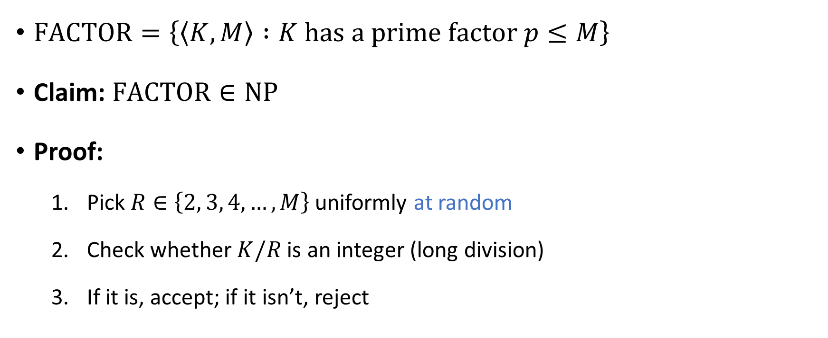
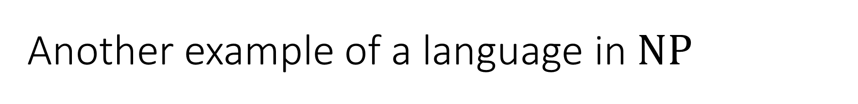
Another example of a language in $\text{NP}$
$\text{FACTOR}=\left\{\left\langle K,M\right\rangle :K \text{has} \text{a} \text{prime} \text{factor} p≤M\right\}$
Claim: $\text{FACTOR}∈\text{NP}$
Proof:
Pick $R∈\left\{2, 3, 4, …, M\right\}$ uniformly at random
Check whether $K/R$ is an integer (long division)
If it is, accept; if it isn’t, reject

Slide 14
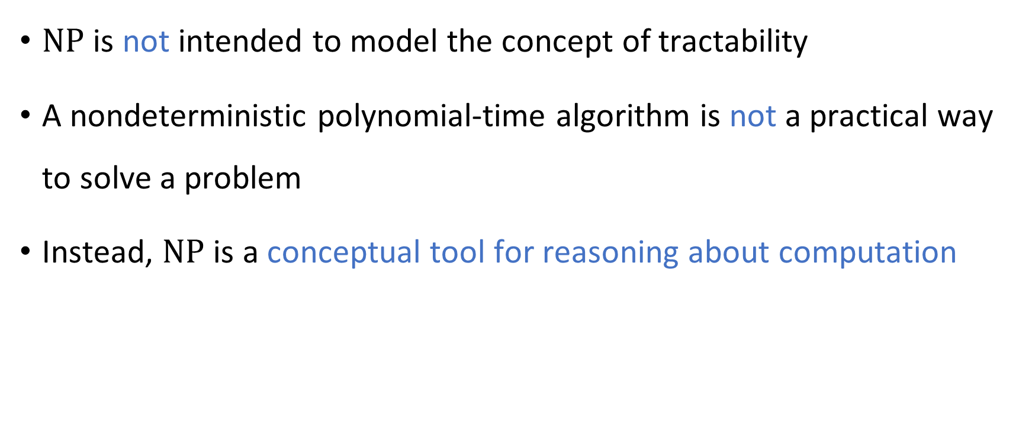
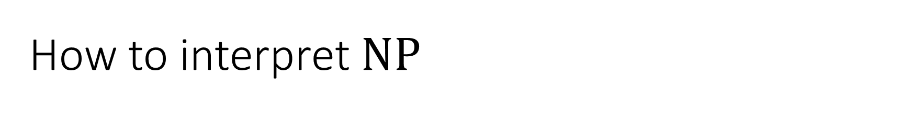
How to interpret $\text{NP}$
$\text{NP}$ is not intended to model the concept of tractability
A nondeterministic polynomial-time algorithm is not a practical way to solve a problem
Instead, $\text{NP}$ is a conceptual tool for reasoning about computation

Slide 15
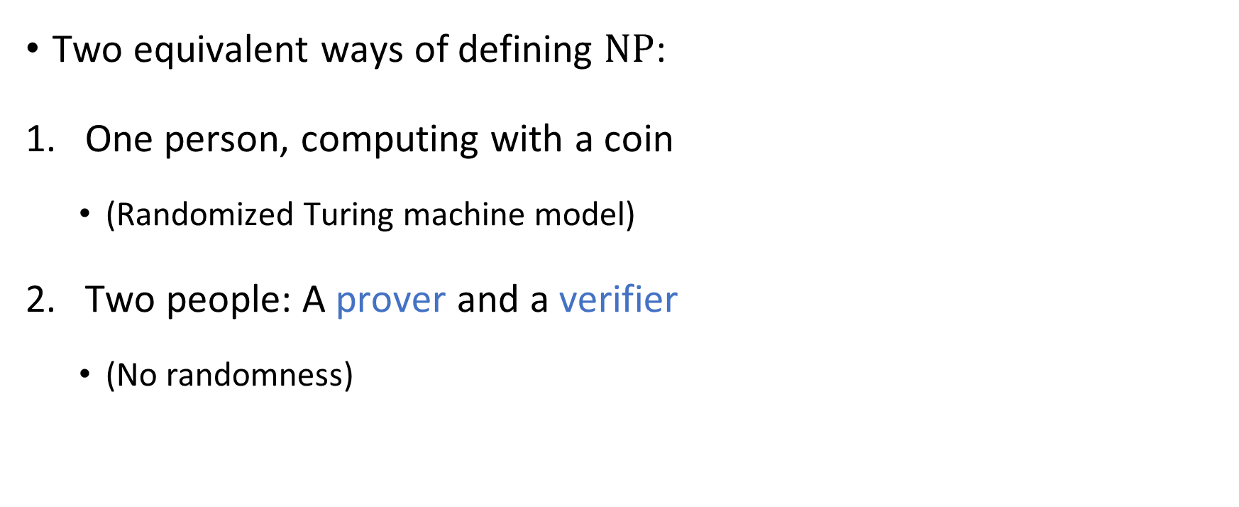
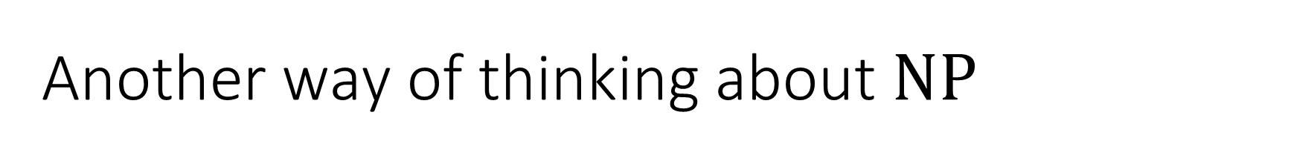
Another way of thinking about $\text{NP}$
Two equivalent ways of defining $\text{NP}$:
One person, computing with a coin
(Randomized Turing machine model)
Two people: A prover and a verifier
(No randomness)

Slide 16


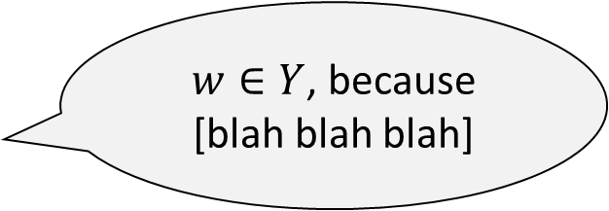
Prover and verifier
$w∈Y$, because [blah blah blah]
Accept/Reject
Prover (Computationally Unbounded)
Verifier (Polynomial Time)

Slide 17

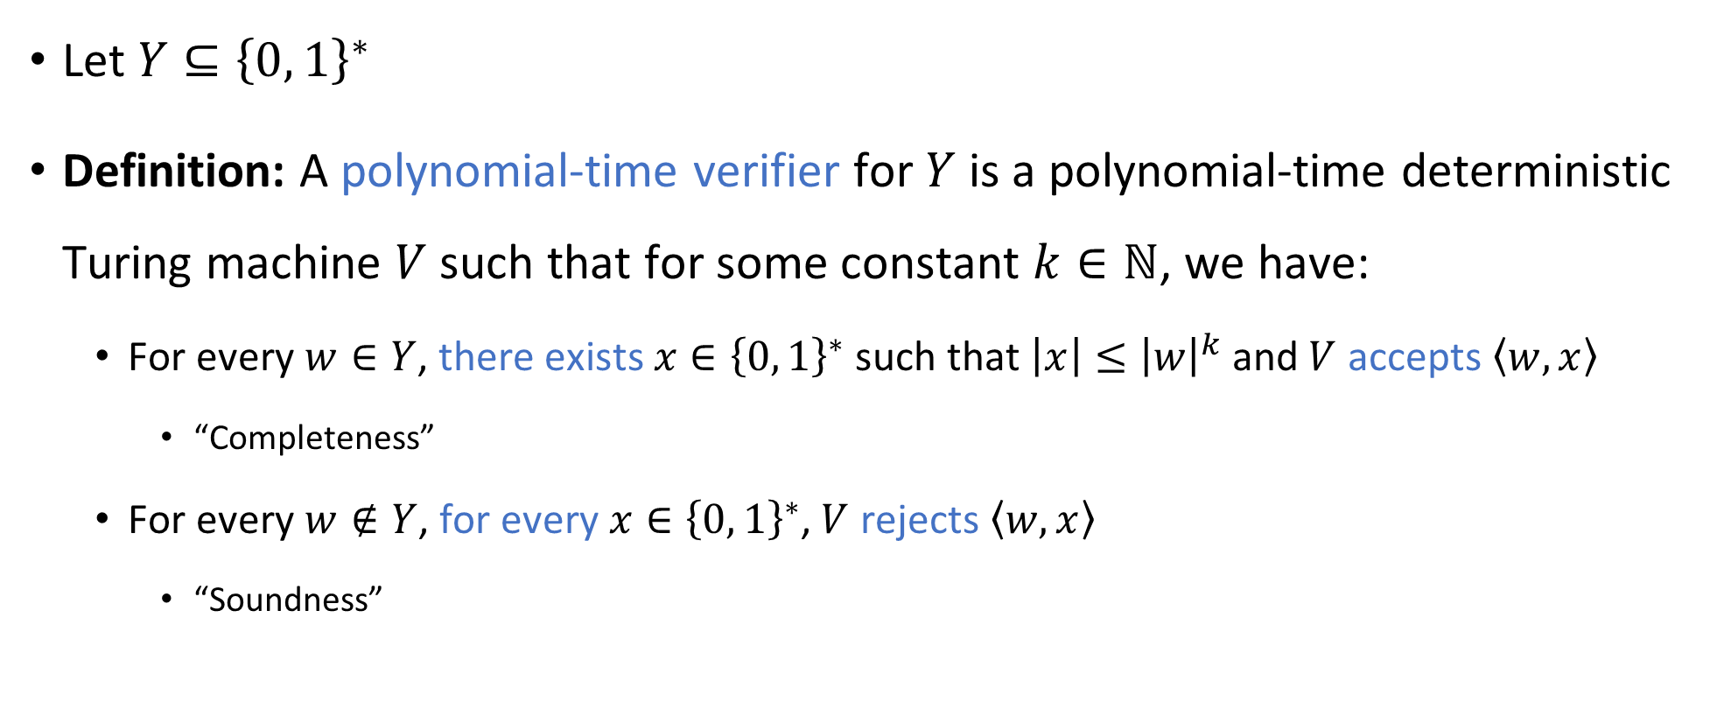
Prover and verifier
Let $Y⊆{\left\{0, 1\right\}}^{∗}$
Definition: A polynomial-time verifier for $Y$ is a polynomial-time deterministic Turing machine $V$ such that for some constant $k∈ℕ$, we have:
For every $w∈Y$, there exists $x∈{\left\{0, 1\right\}}^{∗}$ such that $\left|x\right|≤{\left|w\right|}^{k}$ and $V$ accepts $\left\langle w,x\right\rangle$
“Completeness”
For every $w∉Y$, for every $x∈{\left\{0, 1\right\}}^{∗}$, $V$ rejects $\left\langle w,x\right\rangle$
“Soundness”
“Proof” / “Certificate” / “Witness”

Slide 18
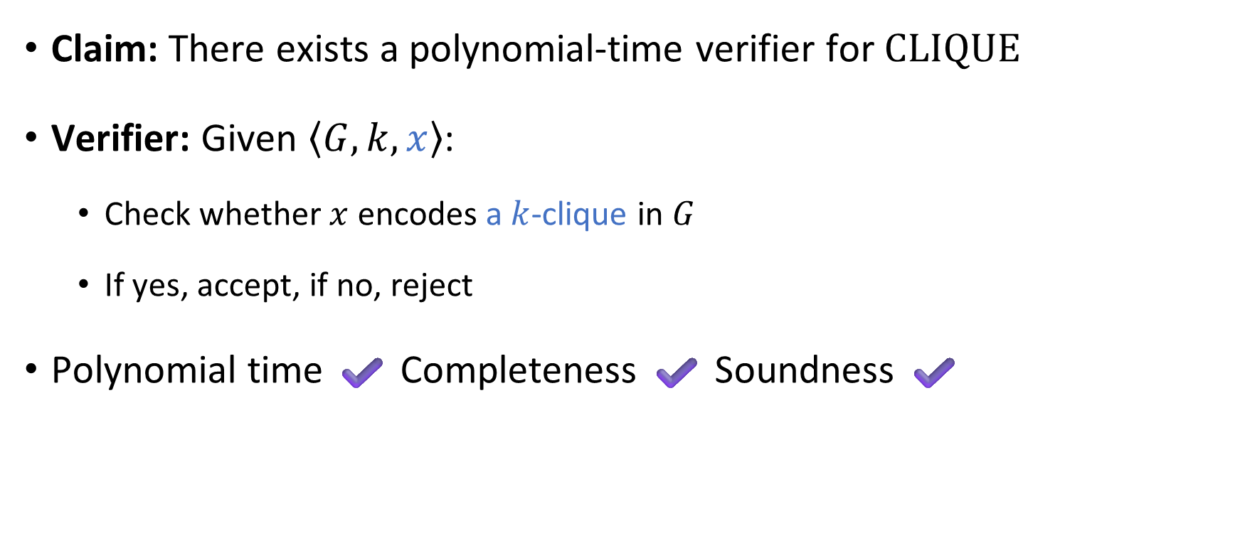

Example: $\text{CLIQUE}$
Claim: There exists a polynomial-time verifier for $\text{CLIQUE}$
Verifier: Given $\left\langle G,k,x\right\rangle$:
Check whether $x$ encodes a $k$-clique in $G$
If yes, accept, if no, reject
Polynomial time ✔️ Completeness ✔️ Soundness ✔️

Slide 19
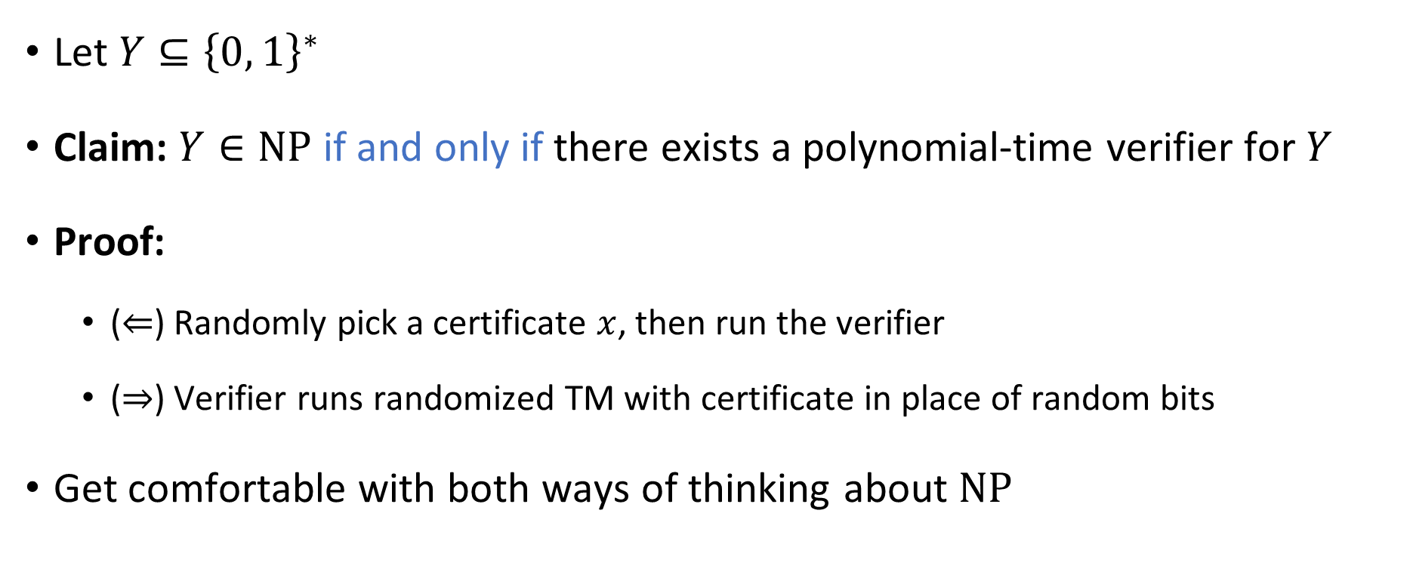
Equivalence of the two definitions
Let $Y⊆{\left\{0, 1\right\}}^{∗}$
Claim: $Y∈\text{NP}$ if and only if there exists a polynomial-time verifier for $Y$
Proof:
($⇐$) Randomly pick a certificate $x$, then run the verifier
($⇒$) Verifier runs randomized TM with certificate in place of random bits
Get comfortable with both ways of thinking about $\text{NP}$

Slide 20

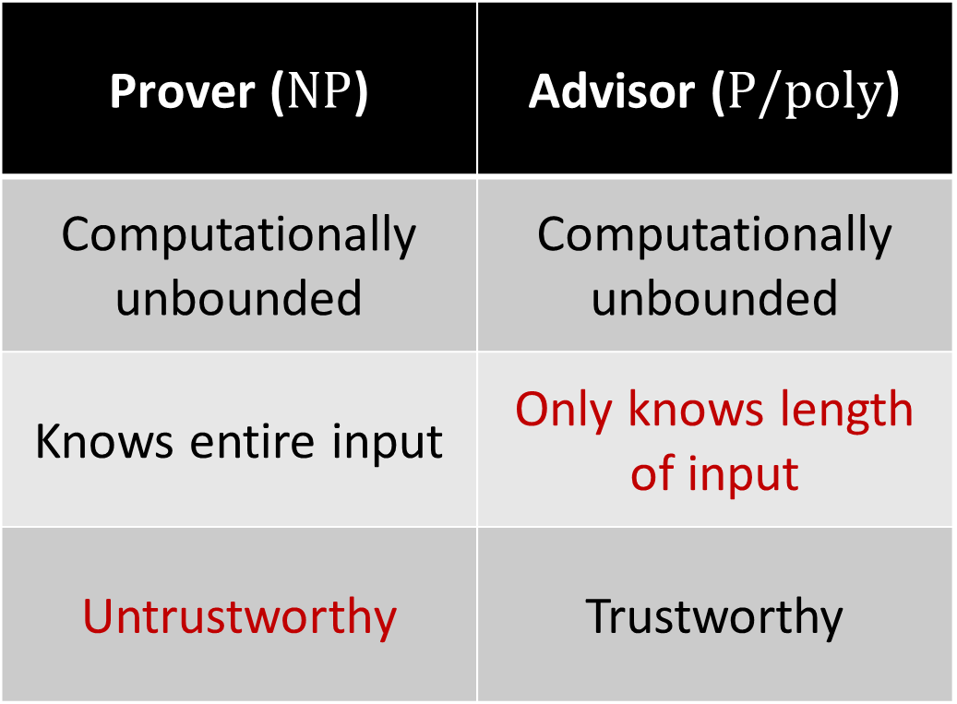

Comparing $\text{NP}$ and $\text{P}/\text{poly}$
Prover ($\text{NP}$) | Advisor ($\text{P}/\text{poly}$)
Computationally unbounded | Computationally unbounded
Knows entire input | Only knows length of input
Untrustworthy | Trustworthy

